Slide 1
Excel and Power BI Project
Harnek Singh -502104169 Shaurya khanna - 502104123 Deepanshu uppal -502104168 KHushbu -502104171

Slide 2
Agenda
01. Introduction
02. Data Cleaning and analysis
Description of the data set
Cleaning the Data to get useful insights.
03. Excel Functions
04. Visualization
05. Power BI
Graphs and charts
Visual representation

Slide 3


Introduction
The data provided to our team was a cumulative vaccine data for the whole country.
A four month window of data was given in the data set.
Primarily the columns consisted of first dose, second dose, covaxin ,covishied data distributed along all the states

Slide 4
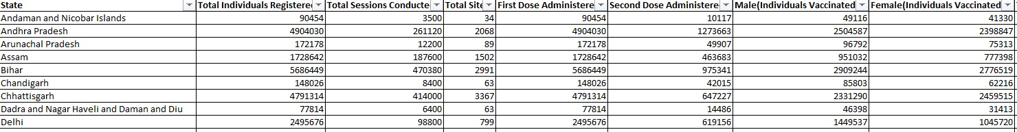

Slide 5
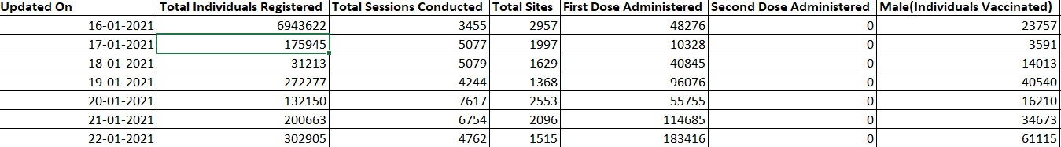
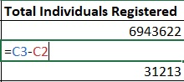
To get useful sense from the data, we first applied pivot table and ensured that the data was arranged in the ascending order of dates once that happened we converted the cumulative data by subtracting values from the next cell by previous cell and storing it the in the same cell.
Basic formula to convert cumulative data
For the ease of working data set for India as a whole state was extracted.
The time frame of this data set was from 16 January 2021 to 17 April 2021.

Slide 6
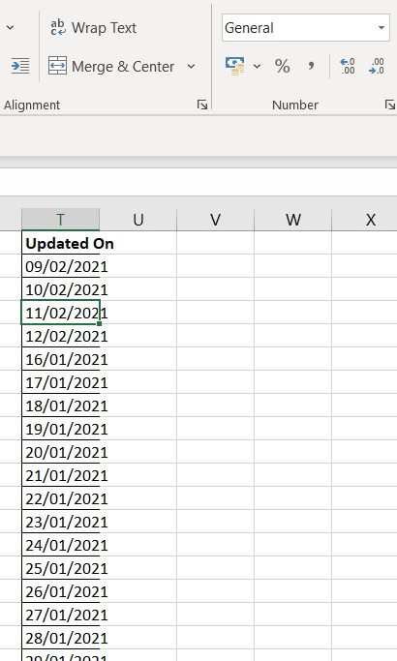
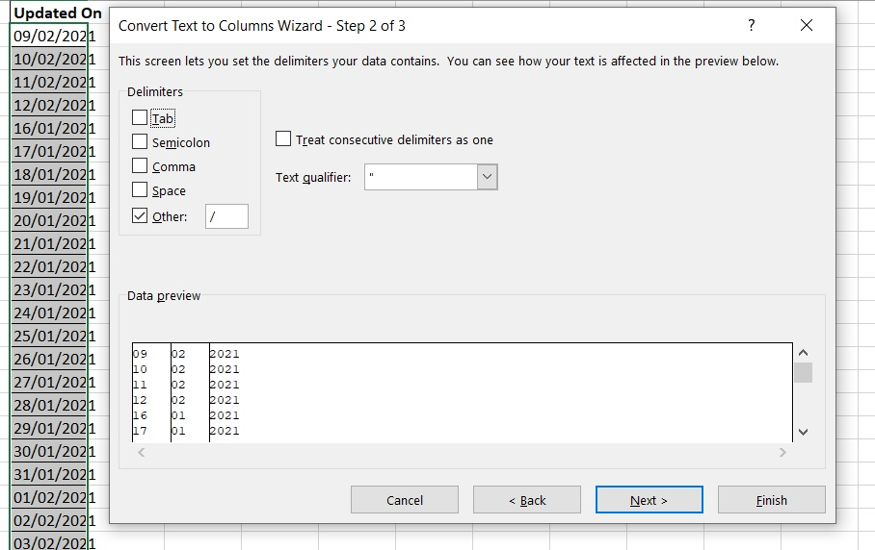
Conversion to Date Format
Date was coming in General Format, simply converting it to short date was not working for the whole data.
Solution to this problem was using text to columns
Function used-Delimiters

Slide 7
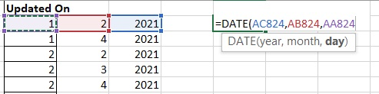
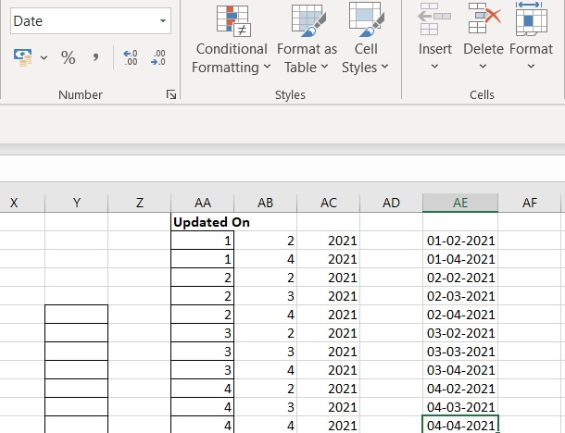
After using Delimiter, the custom date is disintegrated into three columns.
Now the normal Date Function is used to convert it into the date format.
Now the Updated Column is converted to Date format, which can now be used for analysis.

Slide 8
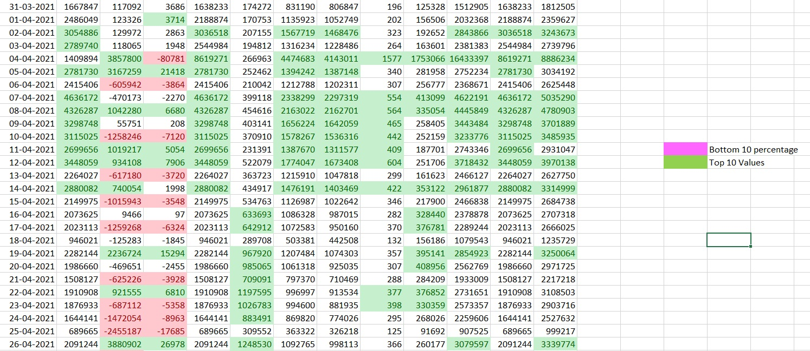
Conditional Formatting on India Data set

Slide 9
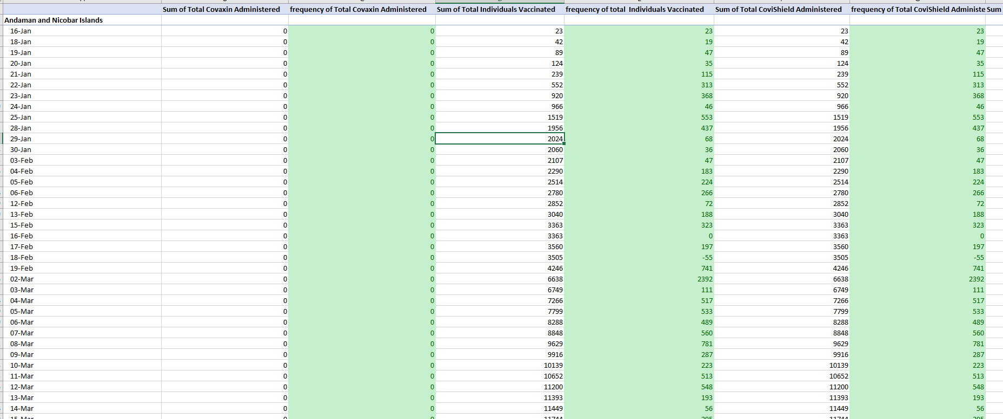
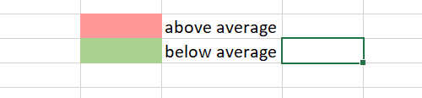
NORMAL Frequency arranged according to states using pivot table

Slide 10
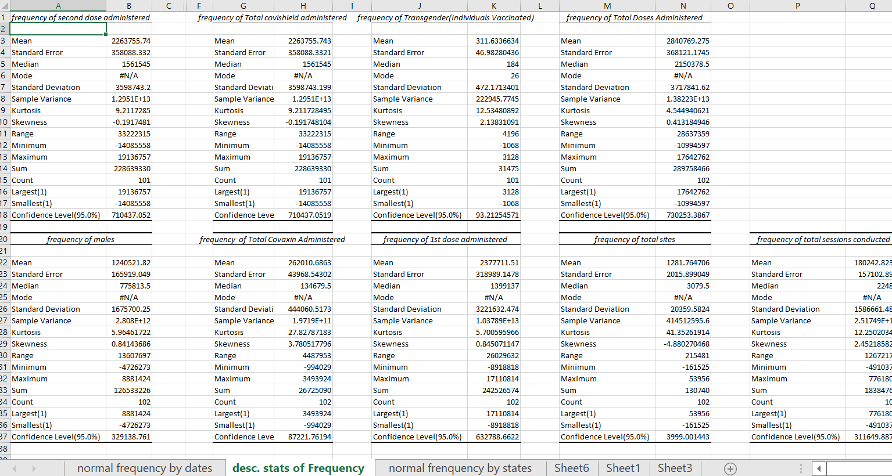
Descriptive statistics of normal frequencies using data analysis tool pack

Slide 11
Graphs and Charts for the Data set (India)
From the Line chart positive trend can be seen for the doses that are being administered.

Slide 13
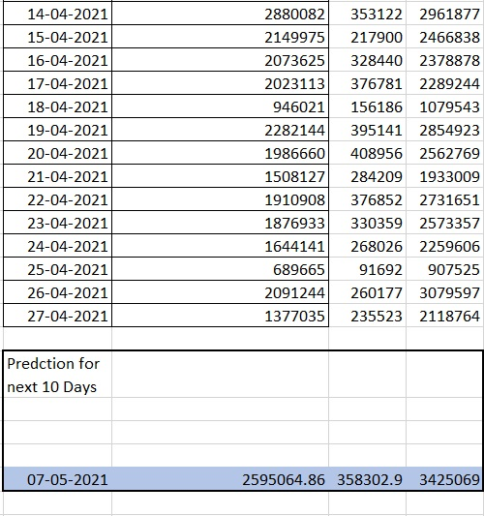
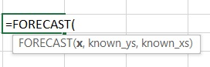
Using for Forecast Function to predict values for next 10 days
X= date we want to predict value for. Eg – 07-05-2021
Known_ys= Total Individual Registered
Known_xs= Updated on

Slide 14
Graphical Evidence to support Forecasted Values
The trendline in orange colour predicts the value after 10 days to be around 2500000.
The value coming from formula is 2595064
2500000
Graphically and Numerically both results are verified.

Slide 15
Graphical Evidence to support Forecasted Values
The trendline in orange colour predicts the value after 10 days to be around 350000.
The value coming from formula is 358302
350000
The trendline in orange colour predicts the value after 10 days to be around 3500000.
The value coming from formula is 3425069
350000

Slide 16
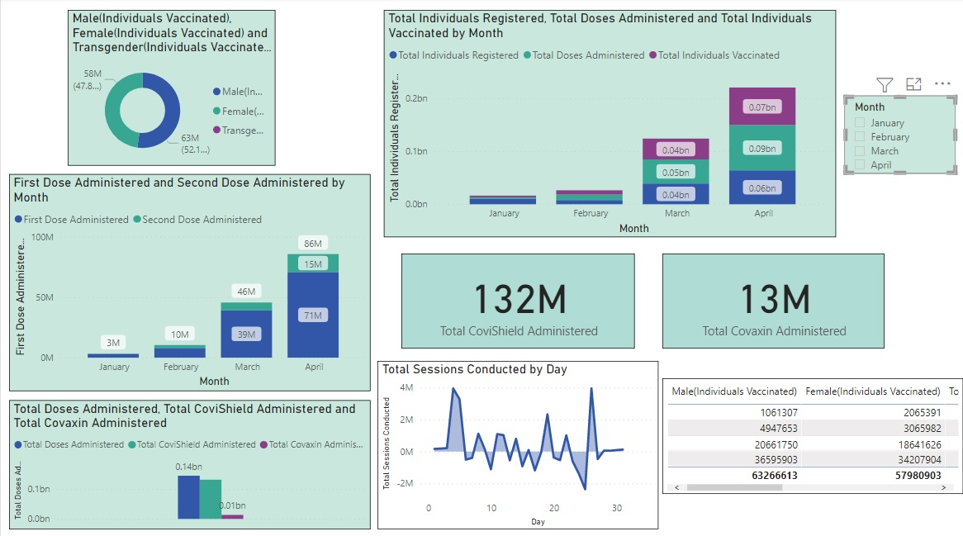
Power BI Dashboard
Dashboard for data considering India as a whole country

Slide 17
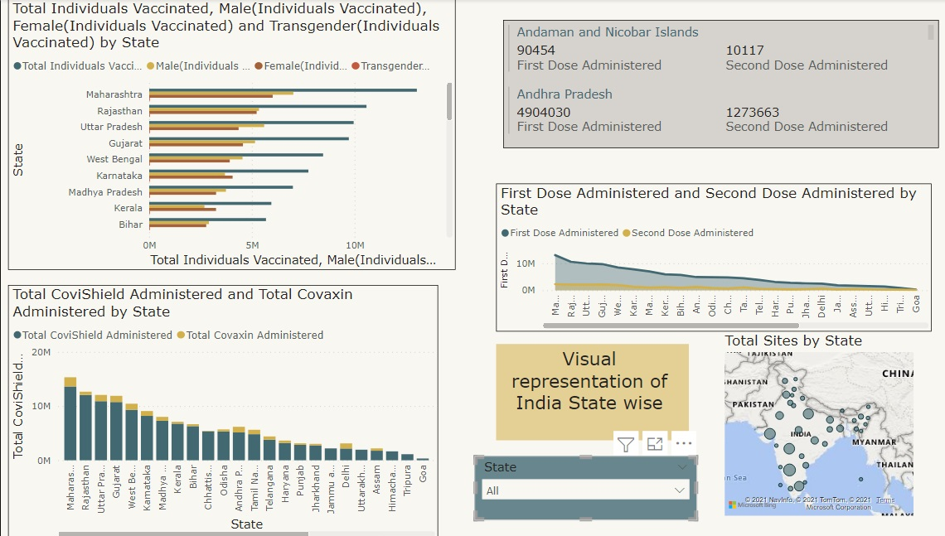
Dashboard for states

Slide 18

Thank you

